Slide 1
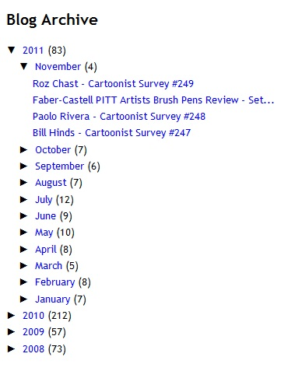
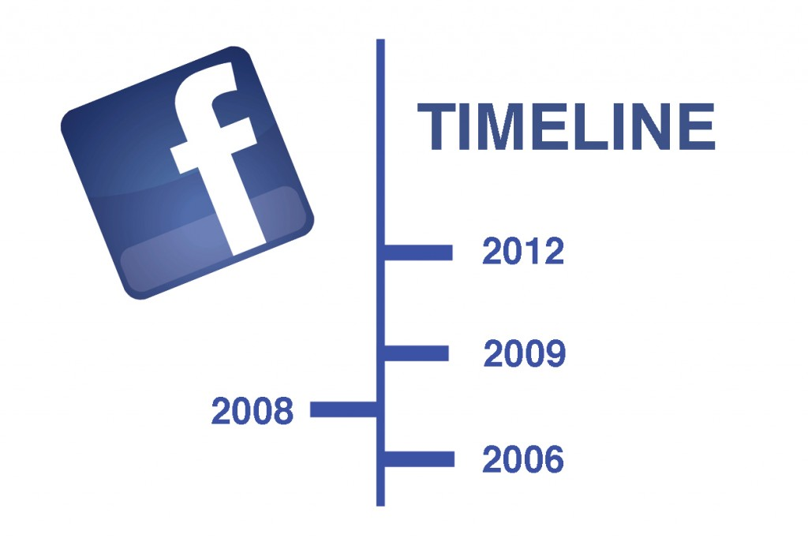
The Backuppers
-Work is already done for us
-Lets us add photos, events, statuses
-We can go back to add information
-Neatly sorted
-Shows number of posts

